Slide 1
Week 4 – C# basics
QA Automation Course

Slide 2
Homework review

Slide 3
What we’ll do today
C# - variables, methods, classes, etc.
WebDriver.Manage() methods
Nunit console-application

Slide 4
C# variables
What a variable is – variable type, variable value;
What an object is;
String, int, float
String s=“Some words”;
s.ToUpper();
int i = 25; int j;
j=i+20;
float f = 2.709823; float g;
g = f*3;

Slide 5
C# variables
IWebDriver variables
IWebDriver driver = new ChromeDriver();
driver.Navigate().GoToUrl("https://yavlenawebsite.melontech.com");
IWebElement
driver.FindElement(By.ClassName("map-search")).Click();

Slide 6
C# variables
IWebDriver variables
IWebDriver driver = new ChromeDriver();
driver.Navigate().GoToUrl("https://yavlenawebsite.melontech.com");
IWebElement
driver.FindElement(By.ClassName("map-search")).Click();
IWebElement el = driver.FindElement(By.ClassName("map-search"));
el.Click();

Slide 7
C# variables
IWebDriver variables
IWebDriver driver = new ChromeDriver();
driver.Navigate().GoToUrl("https://yavlenawebsite.melontech.com");
IWebElement
driver.FindElement(By.ClassName("map-search")).Click();
IWebElement el = driver.FindElement(By.ClassName("map-search"));
String t = el.Text;
el.Click();

Slide 8
C# methods
What is a method
Executing method on an object
driver.FindElement(By.ClassName("map-search"));
Method implementation: return type, parameters
public void Test1()
{
…
}
Executing methods consequently
driver.FindElement(By.ClassName("map-search")).Click();
What methods do in Nunit: they are Tests
public IWebElement FindElement (By selector)
{
…
}

Slide 9
C# classes
What is a class
Classes in Nunit: they are test suites

Slide 10
C# others
Namespace
Using
?
Questions?

Slide 11
Demo
C# create new classes for each team member
Avoid code duplication by using methods

Slide 12
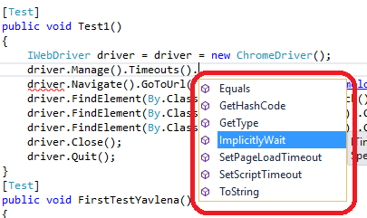
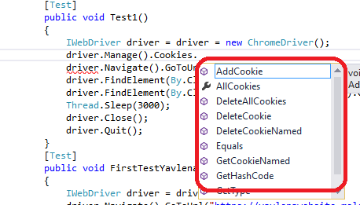
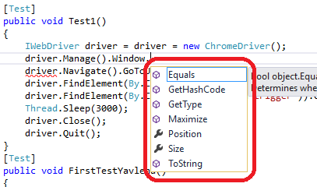
WebDriver Manage
Timeouts
driver.Manage().Timeouts()
.ImplicitlyWait(System.TimeSpan.FromSeconds(10));
Cookies
driver.Manage().Cookies
.DeleteAllCookies();
Window
driver.Manage().Window
.Maximize();

Slide 13
Nunit console-application
https://github.com/nunit/docs/wiki/Console-Runner start page
https://github.com/nunit/docs/wiki/Console-Command-Line docs
http://nunit.org/?p=download download

Slide 14
Nunit console-application
Demo – run all tests from the project in console app
Run a single test in console app

Slide 15
Homework
Copy your tests from the Tests class to the newly created class for you
Try to remove all the Thread.Sleep(xxx); from your tests (using driver.Manage().Timeouts)
Add command to maximize your window in the beginning of each of your tests (so that you are sure you are testing Desktop version of the website)
Optional homework Console-application
Run all tests from our project using console app
Run all YOUR tests (e.g. the tests that you recently moved to the class named on you) using console app

Slide 16
Q & A

